Slide 1
trAIner
the AI game

Slide 2

"We were supposed to make AI do all the work and we play games but we do all the work and the AI is playing games!”
- Andrey Karpathy

Slide 3

Table of Contents
Introduction
Functionality
Features
Diagrams
Genetic Algorithm
Timeline
Tools and Technology
Requirements
Lessons Learnt
Future Work
Live Demo

Slide 4

Introduction
Single, Multiplayer cross platform game
Implementing the concept of Artificial Intelligence in a JAVA based application.
trAIner is an absorbing, immersive game experience
Lets the player develop and train their own AI
Lets the user build his own maps

Slide 5
Creators
Team Members
Rahul Tak
Lucas Mahler
Patrick Gautheret
Kasparas Gudzius
Oleksandr Shlapak
CTS 5
Github: takrahul
CTS 5
Github: Lugges991
CTS 5
Github: ElectrifyPowr
CTS 5
Github: kasparasGud
CTS 5
Github: oleksandrshlapak

Slide 6
Audience
Gaming Lovers
Technology enthusiasts
Artificial Intelligence geeks

Slide 7
Features
AI opens the door of a new era of playing video games
Build your own maps
Let the AI play
Play the game

Slide 8







Tools and technology
Tools:
IDE’s IntelliJ, Eclipse
VIM
Slack
Trello
Technology:
Java
Genetic Algorithm
CSV

Slide 9
Functionality
Three Modes:
User/Player Mode
AI/Computer Mode
Build Mode

Slide 10
Functionality
Play the default loaded map
Load different maps
Build own maps
User / Player Mode:
Build custom maps:
Place/delete building blocks
Place/delete enemies
Save maps
Build Mode:

Slide 11
Functionality
Let AI do the JOB!
Train your AI
Load different maps
Modify AI parameters
View AI performance statistics
AI Mode:

Slide 12
Diagrams
Use cases:
Build Map
AI Game
Player Game

Slide 13
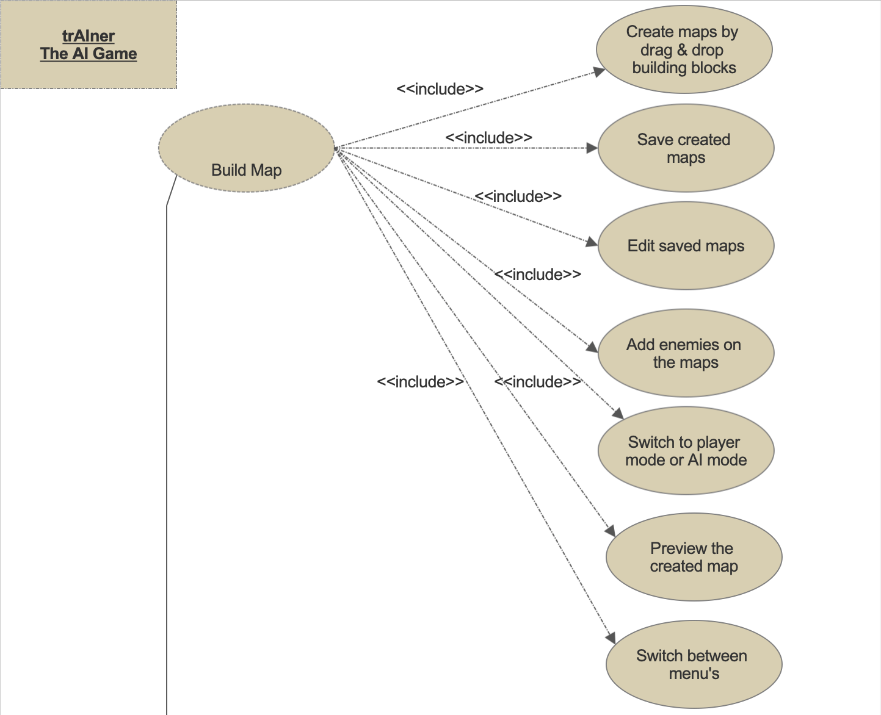
Build Map

Slide 14
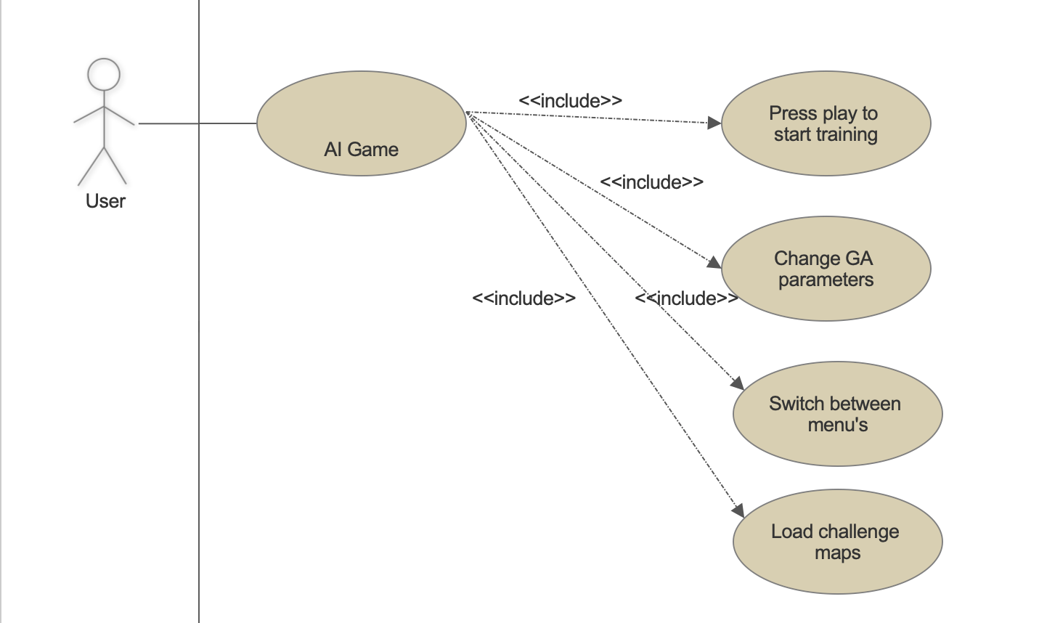
AI Game

Slide 15
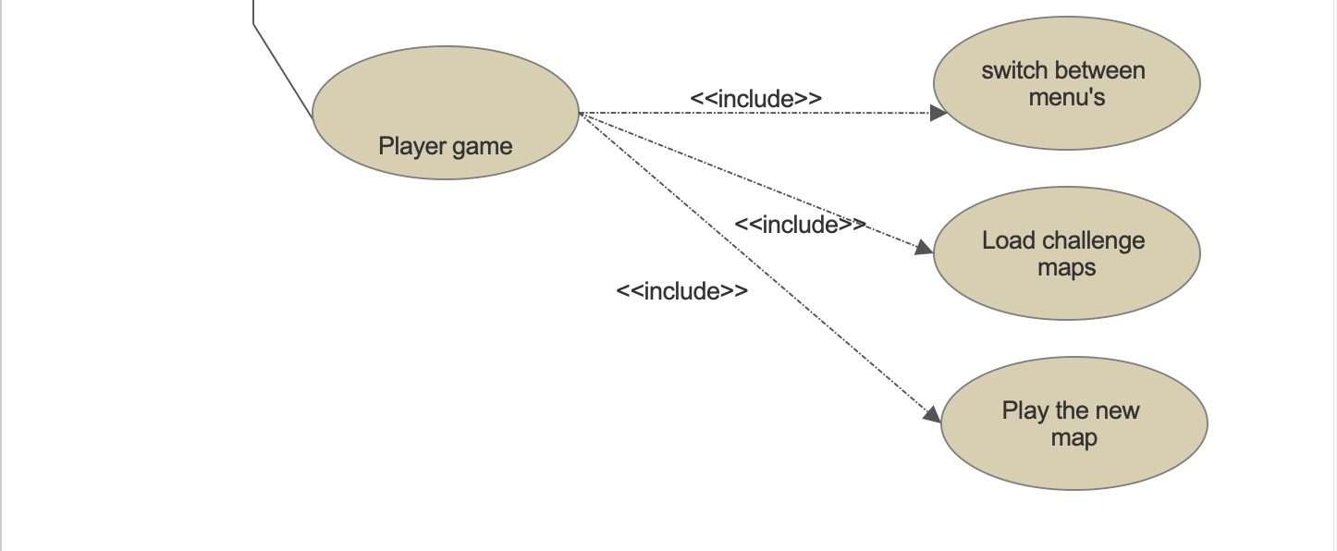
Player Game

Slide 16
Genetic Algorithm
Population Initialize
.
.
Create Individuals
Create genes of individuals
Randomly initialize genes

Slide 17
Genetic Algorithm
Population Initialize
.
.
Create Individuals
Create genes of individuals
Randomly initialize genes

Slide 18
Genetic Algorithm
Population Initialize
.
.
Create Individuals
Create genes of individuals
Randomly initialize genes

Slide 19
Genetic Algorithm
Population Initialize
.
.
Create Individuals
Create genes of individuals
Randomly initialize genes

Slide 20
Genetic Algorithm
Population Initialize
Population Initialize
Population Initialize
.
.
.
.
.
.
Create Individuals
Create Individuals
Create genes of individuals
Create genes of individuals
Randomly initialize genes
Randomly initialize genes
Evolution
Evaluation
Fitness Value

Slide 21
Genetic Algorithm
Population Initialize
.
.
Create Individuals
Create genes of individuals
Randomly initialize genes
Evolution
Evaluation
Fitness Value

Slide 22
Genetic Algorithm
Population Initialize
Population Initialize
Population Initialize
.
.
.
.
.
.
Create Individuals
Create Individuals
Create genes of individuals
Create genes of individuals
Randomly initialize genes
Randomly initialize genes
Evolution
Evaluation
Fitness Value

Slide 23
Genetic Algorithm
Population Initialize
Population Initialize
Population Initialize
.
.
GA Operators
.
.
.
.
Create Individuals
Mutation
Create Individuals
Create genes of individuals
Create genes of individuals
Randomly initialize genes
Crossover
Randomly initialize genes
Evolution
Reproduction
Evaluation
Fitness Value

Slide 24
Genetic Algorithm
Population Initialize
Population Initialize
Population Initialize
.
.
GA Operators
.
.
.
.
Create Individuals
Mutation
Create Individuals
Create genes of individuals
Create genes of individuals
Randomly initialize genes
Crossover
Randomly initialize genes
Evolution
Reproduction
Evaluation
Fitness Value

Slide 25
Genetic Algorithm
Population Initialize
Population Initialize
Population Initialize
.
.
GA Operators
.
.
.
.
Create Individuals
Mutation
Create Individuals
Create genes of individuals
Create genes of individuals
Randomly initialize genes
Crossover
Randomly initialize genes
Evolution
Reproduction
Evaluation
Fitness Value

Slide 26
Requirements
Technical Constraints
Budget | 750 Hours
Scope | AI based system
Platform Supported | All platforms supporting Java
Schedule | 04.10.18 - 24.01.19
Non Functional Constraints
Portability | Each java capable device can run the game
Usability | User friendly and long term satisfying game
Cost | Minimal installation and setup efforts

Slide 27

Architectural Patterns
Game Loop
Double Buffer
Type Object

Slide 28


Type objects

Slide 29
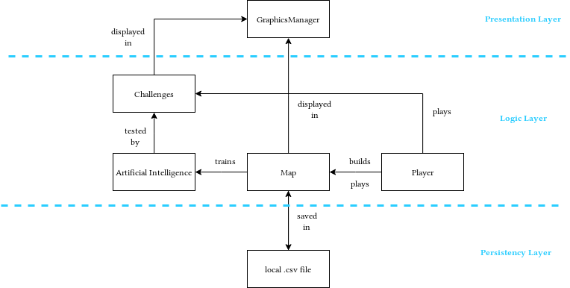
Domain model

Slide 30
Timeline
Development I
Design
UI coding
Starting phase Genetic Algorithm
Transition
Finishing touches
Documentation
Presentation
October
November
December
January
Inception
Planning
Diagrams
Architecture and Design
Development II
GA finished
Project finishing stage
Testing

Slide 31
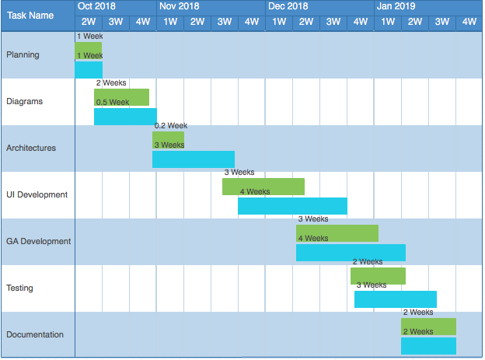
Project Management
Planned
Actual

Slide 32
Lessons Learnt
Managing project on Github (branching and merging)
Importance of scrum meetings
Use of proper diagram formats
Proper time planning
Coherent task distribution

Slide 33
Future Work
Scoreboard
Reusing pre-trained AI
Reinforcement learning

Slide 34
Preview
LIVE DEMO

